Slide 1
Shop Safety
Mr. Price

Slide 2
Outline
General Shop Safety
Dangers Associated with working in the shop

Slide 3
General Shop Safety
Housekeeping
Fire Prevention
Management

Slide 4
Housekeeping
Cleaning work areas
Sweeping—prevent slips and falls
Keeping designated walking areas clear of debris
Restoring equipment and tools after job is completed

Slide 5
Fire Prevention
Discard frayed cords and wires
Keep flammable liquids away from heat

Slide 6
Fire Extinguishers
There are four types of extinguishers:
Type A
Type B
Type C
Type D
Each type is designed to put out fires on certain types of materials.
Using the wrong type of extinguisher can be dangerous, either causing fire to spread, causing electrical shock, or causing an explosion.

Slide 7
Type A Extinguishers
Used for combustible solids such as:
Paper
Wood
Cloth
Symbol is a green triangle with the letter A in the center.

Slide 8
Type B Extinguishers
Used for combustible liquids, such as:
Oil
Gas
Paint Thinner
Symbol is a red square with the letter B in the center.

Slide 9
Type C Extinguishers
Used for electrical fires:
Fires involving motors, fuse boxes, and welding machines
Symbol is a blue circle with the letter C in the center.

Slide 10
Type D Extinguishers
Used on fires involving combustible metals, such as zinc, magnesium, and titanium.
Symbol is a yellow star with the letter D in the center.

Slide 11
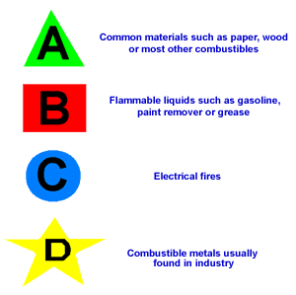

Slide 12
Location of Extinguishers
Ag shops should have all four types of extinguishers.
Placed at a low level making them easy to lift.
Marked with red paint and signs.
Located by the main door.

Slide 13
Management
Safety programs—training, meetings, etc.
Emergency phone numbers
Found on a sheet by the phone

Slide 14
Shop Safety
Eye Protection
Dress Code
Behavior
Ventilation

Slide 15
Eye Protection
“An ounce of prevention is worth a pound of cure” when it comes to eye protection
Always wear proper eye protection when working in the shop
A welder must be protected from harmful light radiation given off by the welding process
For welding you will be using chipping goggles and a welding helmet

Slide 16
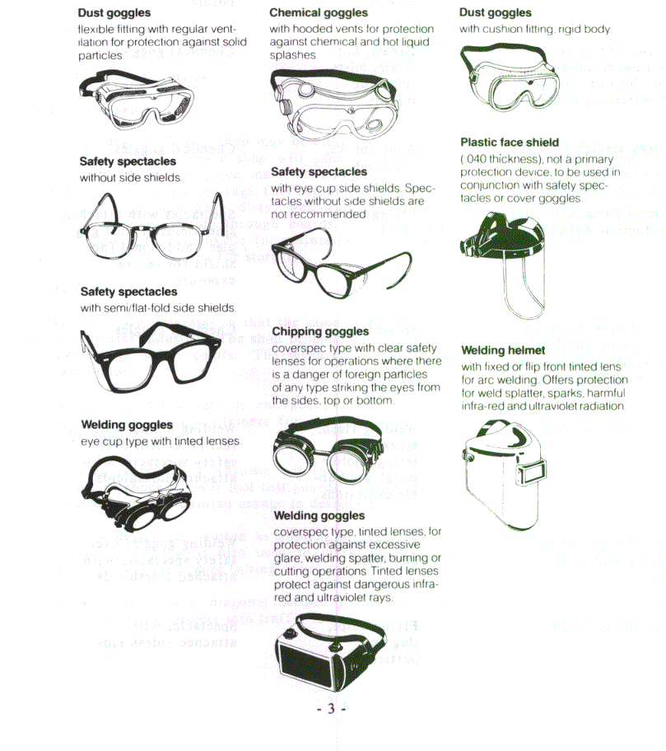

Slide 17
Dress Code
Wear properly fitted clothes.
When welding, sleeves should be buttoned and gloves should be worn.
Wear boots or high top; Tightly laced shoes.
Do not wear loose clothing, shirt tails, open-toed shoes and unbuttoned sleeves around power equipment.
Do not wear clothes that you do not want to get dirty.

Slide 18
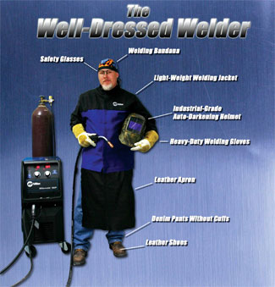

Slide 19
Behavior
Most accidents are caused by carelessness
Caused by human error
Refrain from getting involved in poor
shop behavior:
scuffling playing with tools
tripping running
pushing hurrying projects
disobeying shop rules loud talking

Slide 20
Ventilation
Welding fumes can be harmful to the welder causing implications such as:
Irritation of the respiratory tract
Slightly increase the risk of lung cancer
Welding should be done in a well ventilated area
Should attempt to control fumes at the source
Common ways
Extracted benches
Local exhaust ventilation

Slide 21
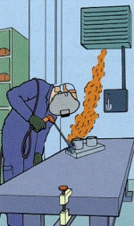
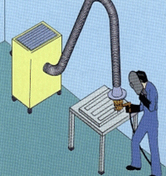
Proper Ventilation Systems

Slide 22
Dangers Associated with Welding
Electrical Shock
Harmful Fumes
Burns
Radiant energy

Slide 23
Electrical Shock
Electric shock can kill and may be caused by:
Standing in damp areas
Welding without gloves
Bare cables
Un-insulated holder

Slide 24
Harmful Fumes
Given off in welding process especially when welding on galvanized or other coated materials.
Good ventilation can prevent this from occurring.
If working in a confined area use respirator or other approved breathing devices.

Slide 25
Burns
Wear adequate protective clothing.
Always wear leather gloves.
Wear high top shoes.
Keep collar, shirt pockets, etc buttoned.

Slide 26
Radiant Energy
Use a welding helmet with the correct shade lens in good condition.
Wear suitable clothing—do not leave bare skin exposed to the rays of the arc.
Do not strike the arc without covering the face and eyes. Give warning to others before striking the arc.
Avoid looking directly at the arc where others are welding without proper eye protection.

