Slide 1
The Great Depression

Slide 2
Today in U.S. History B
Bell Ringer
Notes- False Sense of Security & the Crash
Exit Slip
I can….analyze the factors, events, and economic conditions that led to the Great Depression.

Slide 3
The 20s that Roared

Slide 4
The Twenties that Roared
For some the Roaring 20s were not a time of economic prosperity
Overall, the American economy saw a period of sustained growth
  The GNP (Gross National Product- the total value of goods and services produced in a nation during a specific period) rose by 30% between 1922 and 1928
  Automobile industry helped drive the expansion of the economy. 1 in 5 Americans owned a car
  Unemployment was very low (3%)
  Consumerism dictated the economy
Average Americans knew very little about the economy. The rapid growth trigged a feeling of optimism → led to reckless activities..

Slide 5
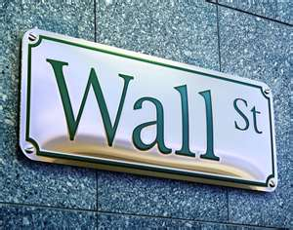
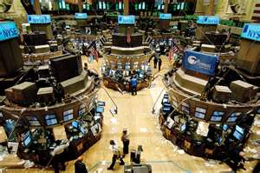
The Twenties that Roared
Stock Market
  Stock- ownership in the company
  Shares- portion of a company that is sold
  Buying shares of stock = buying a piece of a corporation
  The stock market of the 1920s performed well – the trend in stock prices was sharply upward
  # of shares rose sharply during the 1920s- 318 million in 1920 to 1 billion in 1929 ….. Everyone was buying stocks!!
  Stock Market Basics - How the New York Stock Exchange Works - Tutorial Cartoon (1952) - YouTube

Slide 6
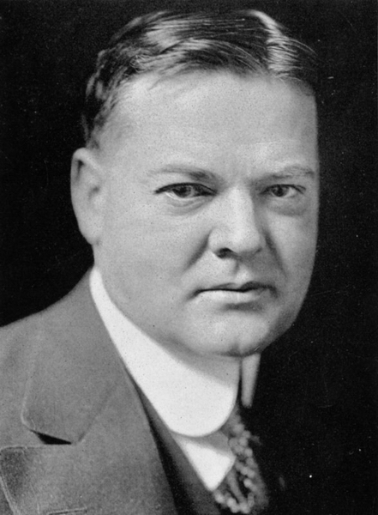
The Twenties that Roared
Election of 1928
  Republican Candidate = Herbert Hoover
    Never held an elected position
    Secretary of Commerce under Harding & Coolidge
    Quaker; supported Prohibition
  Democratic Candidate = Al Smith
    Outgoing politician
    Catholic; supported alcohol sales
    Hoover overwhelmingly won the election!
    How do Republicans typically view the relationship between business and government?

Slide 7
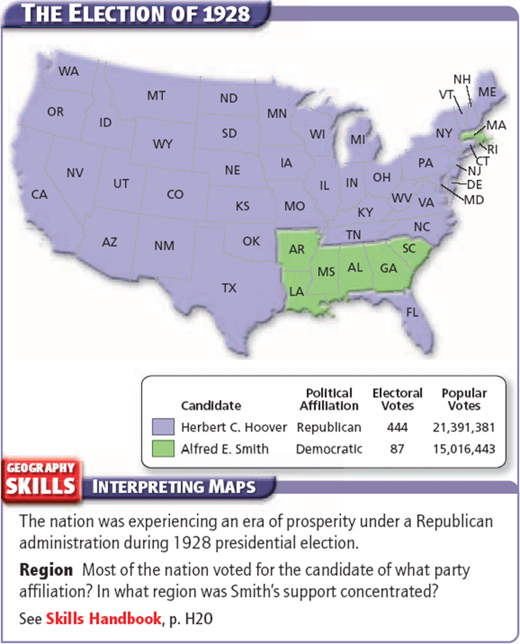

Slide 8
A False Sense of Security
Was the American economy as prosperous as everyone thought?

Slide 9
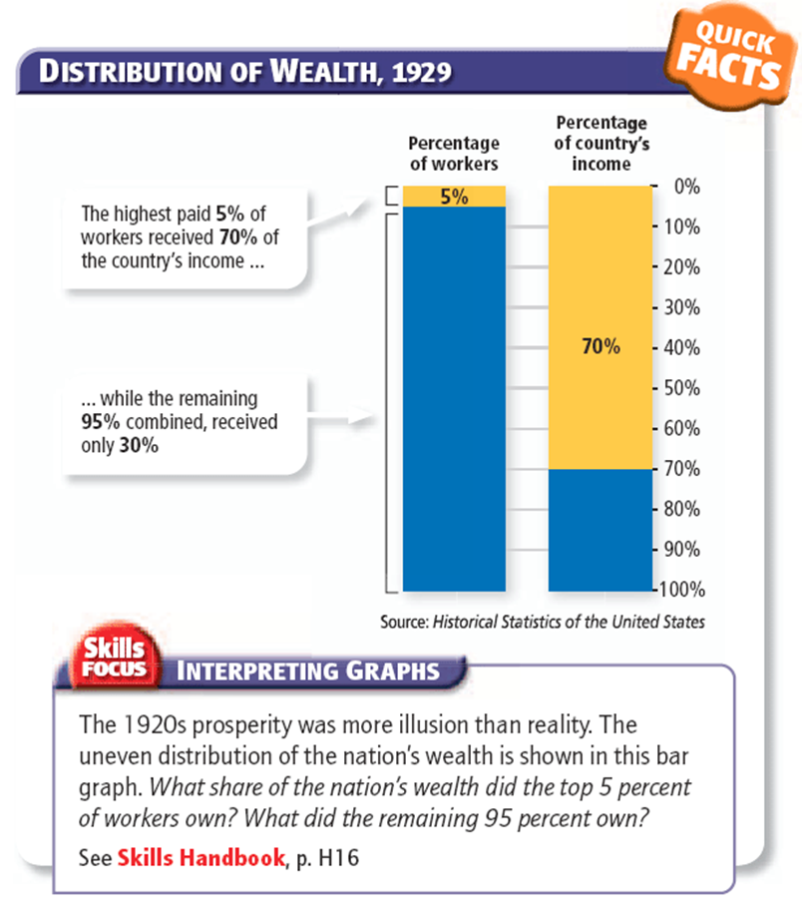

Slide 10
Unequal distribution of wealth…
America had a vastly uneven distribution of wealth
Despite the economic boom- only a small percentage were taking in a dramatic increase in wealth
  1% of the population had seen their share in the national income grow 60% from 1920-1929
  Average American worker only saw an increase of 8%
  The economic boom was beginning to look more like an illusion
Sound familiar?

Slide 11
False Consumer Confidence
“Have you bought an automobile yet?”
“No, we felt we couldn’t afford one”
“Mr. Budge has one and he is not as well off as you are”
“Yes, I know. But their second installments came due, and they had no money to pay for it”
“Did they lose the car?”
“No, they got the money and paid the installment”
“How did they get the money?”
“They sold the cook-stove”
“How could they get along without a cook-stove?”
“They didn’t. They bought another one on the installment plan.”

Slide 12
Buying on Credit
Consumer Credit
  By the end of the 1920s, many consumers were seeing the end of their credit limits
  Pace of purchases will slow → demand for goods
Investment Credit
  Investors began to even use credit (from banks or stockbrokers) to buy stocks in a company
  The investor pays a portion of the stock (while the loaner pays the rest) and when the stock is sold, the investor will pay back → buying on margin
  Risks?

Slide 13
Buying on Margin
Investor wants to buy 100 shares of stock in Vasser Company
Each share costs $10; so 100 shares @ $10 = $1000
Investor would pay $500, would borrow $500 from a stockbroker
Enter Risks and Rewards:
  Reward: If price of stock rose to $15 , investor could sell stock for $1,500. They pay back their loan AND make a profit! ☺
  Risk: Price of stock falls to $5, investor would only sell stock for $500. They pay back their loan and make NO profit. ☹

Slide 14
Stock Speculation and Problem…
Buying on Margin encouraged STOCK SPECULATION - people would buy and sell stocks quickly to make a quick buck
All this buying & selling caused stock value to increase (Ex: G.E stock $130 → $396/share)
This quick turnover didn't aid companies → they needed long term investments so they could pay bills (stock value was like an illusion)
Traders would buy and sell shares intentionally to inflate a given companies stock value
All of this gave a false sense of security/confidence in the American market

Slide 15
The Federal Reserve
Federal Reserve: nation’s central bank
Federal Reserve Board: takes actions and set policies to regulate the nation’s money supply in order to promote healthy economic activity
Moved to make it more difficult and costly to offer margin loans to investors
Corporations found away around this- they provided $ to stockbrokers instead of banks
Many began to speculate that a crash in the value of all stocks would soon come…

Slide 16
The Stock Market Crashes
It’s all an illusion
  1928- Market value had a 50% gain
  1929- another 27% gain
Speculation Begins…
  Clear that sales of goods was not what it had been (remember, credit is dying out)
  Fears began that stock prices would soon collapse
    If you heard this and had money in stocks, what would YOU do?
October 24, 1929
  Nervous investors began selling stocks; set off a chain reaction of selling; with few willing to buy
  Stock prices PLUNGED; triggering an even greater panic
  However, leading bankers joined together to buy stocks and prevent a collapse; stopped panic for a short while

Slide 17
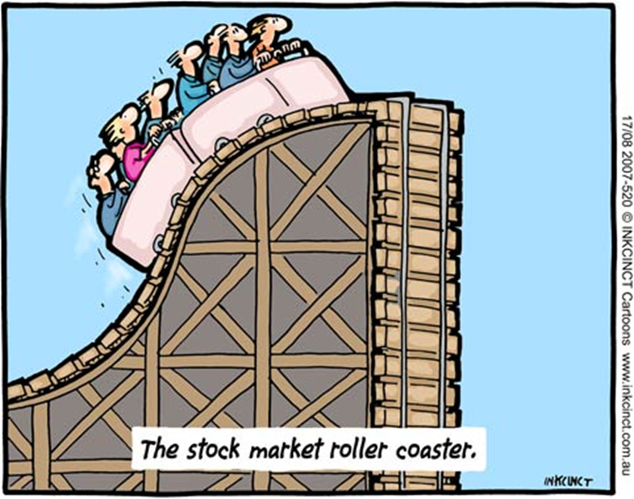
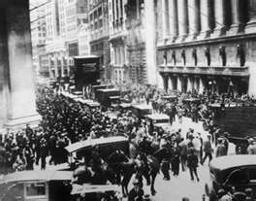
The Stock Market CRASHES
Tuesday, October 29, 1929
  When trading began again on Monday the relief had subsided
  The market began to sink again
  The next day, Black Tuesday, the worst day of the panic
    Investors dumped more than 16 million shares of stock
    During the month of October, the stock market dropped in value by 16 billion

Slide 18
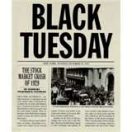
Causes of the Stock Market Crash
List 5 circumstances or
factors that led to the
crash of the Stock
Market.
Predict what problems
are going to occur after
the crash.

Slide 19
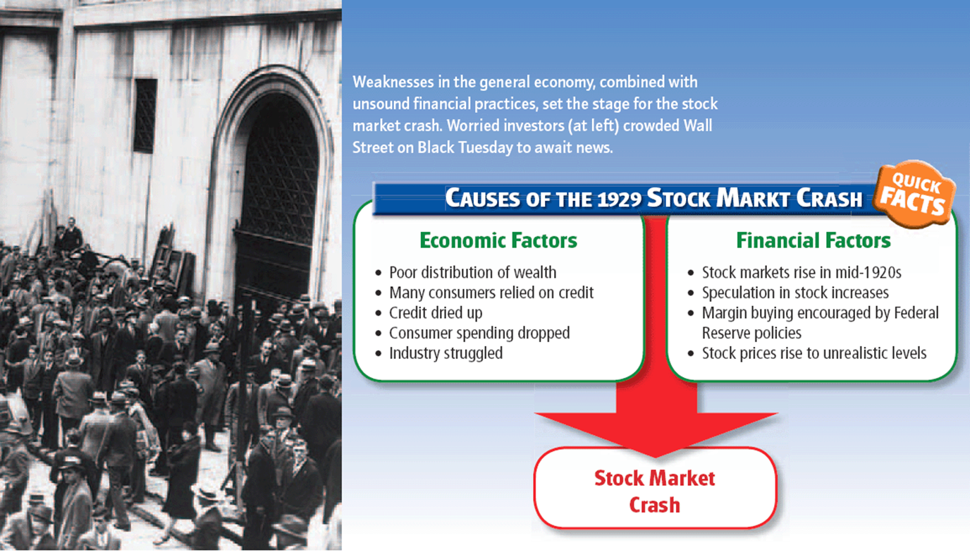

Slide 20
Causes Recap
Welcome to Discovery Education Player

Slide 21
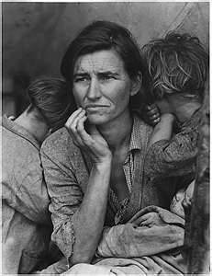
Effects of the Crash & the Human Impact

Slide 22
Today in US History B
Bell Ringer
Notes- Effects of the Crash & Human Impact of Depression
Notes- Dust Bowl
Weekly Quiz #3
I can….assess the impact of the Stock Market Crash and associated economic depression on the average American.

Slide 23
Effects of the Stock Market Crash
After October 29, 1929, the American economy entered into a depression (a sustained, long term downturn in economic activity)
The “Great Depression” represents the years of the worst economic depression America had ever or has ever faced.
The Great Depression lasted from 1929 until the 1940s (after World War II).

Slide 24
Effects of the Stock Market Crash
In the aftermath of the crash, business and political leaders rushed to calm the panic and reassure the nation
Some business executives and even President Hoover downplayed the crash – “The recent collapse of stock market prices has no significance as regards to the real wealth of the American people as a whole”
They were extremely wrong.
Most investors in the Stock Market lost most, if not all, of their wealth.

Slide 25
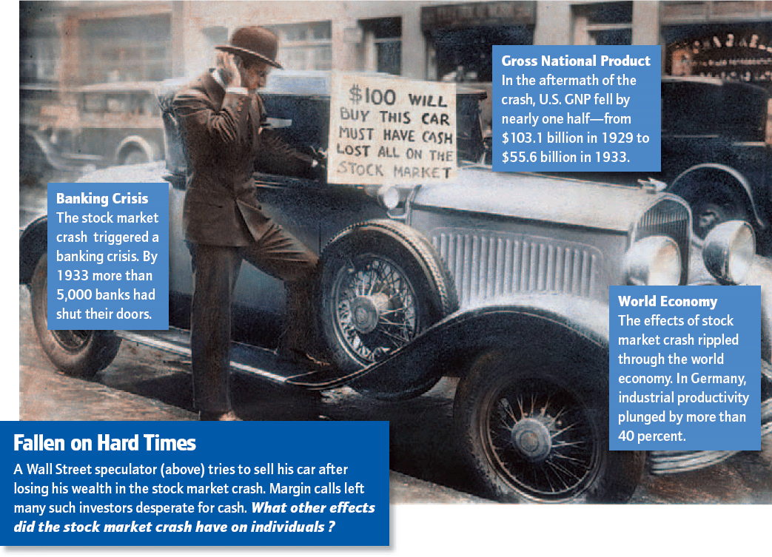

Slide 26
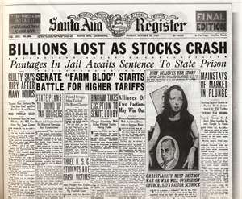
Effects of the Crash
Impact of Individual Investors
  Ruined many individual investors- some lost entire savings!
  Margin buyers were particularly hard hit: brokers demanded that they pay back the borrowed $, to meet the margin call, investors were forced to sell stocks for far less than they had paid for them.
Effects on the banks
  The crash trigged a banking crisis
  Frightened depositors rushed to withdraw their money, draining banks of $
  Many banks had also themselves been investors or loaned money
  Many banks were forced to close….1930 → 1,352 closed, 1931 → 2,294

Slide 27
Effects of the Crash
Effects on business
  All businesses affected, especially those already struggling
  Banks and investors unwilling or able to provide industry with money it needed to grow and expand → Many business will fail
  Consumers cut back on spending, only bought necessities
  Companies began to lay off employee or cut wages → wages dropped by a total of $4 billion
Effects overseas
  The Great Depression impacted economies all over the world, especially Europe who was still struggling from World War One.
  European governments and business could not repay loans
  European business also began laying off workers and cutting wages
  Created high tariffs to try to protect home businesses, but it wasn’t enough!

Slide 28
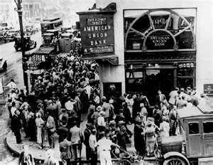

Slide 29
Impact on Average Americans
Banks & Savings Accounts
  Bank runs were popular- nervous depositors suspecting a bank might be in danger of failing, rushed to withdraw their savings
  Runs caused many banks to close
  When banks closed, it hurt the average American who had trusted their savings in the bank.
  Banks in the 1920s did not always have enough assets on hand to maintain the runs & there was no government protection or aid available.
Farm Failures
  The hard times farmers faced in the 1920s only worsened
  Many Americans were not able to buy food and demand for products declined
  By 1933, prices were down more than 50% from their already low 1929 levels
  Lower prices → lower income for farmers → can’t pay bank loans
  In 1933 alone, 364,000 farms went bankrupt or suffered foreclosure (when a bank or other lender takes over ownership of a property fro man owner who has failed to make loan payments)

Slide 30
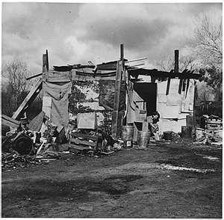
Impact on Average Americans
Unemployment
  In 1929, unemployment was at 3%
  By 1932, unemployment had reached 23.5%
  Without jobs, economic activity plummets (no new clothes, goods, cars, houses, etc)
  Minorities were usually the first to lose their jobs
Homelessness
  With no job or income to sustain a family, many Americans lost their homes
  In many communities, sprawling neighborhoods of shacks sprang up on the outskirts of towns, in public parks, under bridges, etc → Hoovervilles

Slide 31
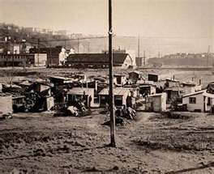
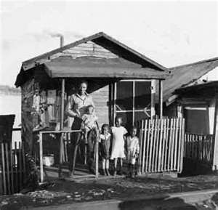

Slide 32
How do we help the American?
Lack of Public Relief
  Only local government relief agencies and charitable organizations such as the Red Cross were able to offer assistance.
  Many local governments closed other public offices to make money (schools, libraries, etc)
  Only 1 in 4 Americans received public relief
  Many Americans also had a negative attitude towards charity
Attempts to sustain
  They made due with what they could
  Change in diets
  Quick cash → pawn, peddling
  Apple Shippers Association- had an oversupply, “sold” apples on credit to individuals who sold them on the street for FIVE CENTS
  Hoboes- homeless wanderers, hopped trains to travel from town to town looking for work or money.

Slide 33
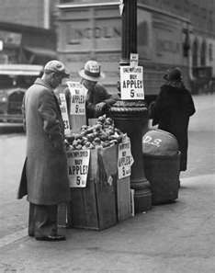
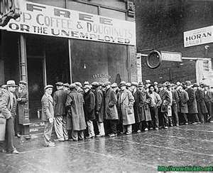

Slide 34
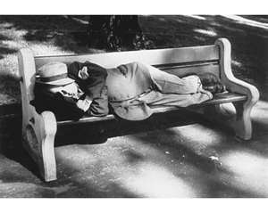
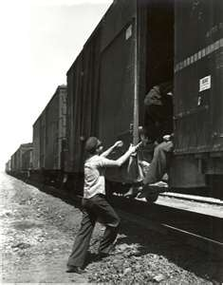

Slide 35
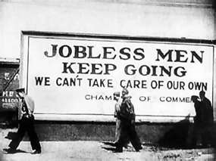
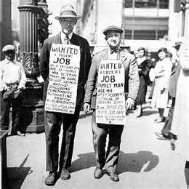
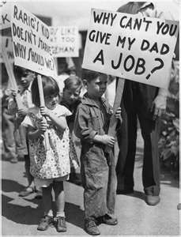
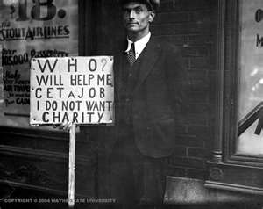

Slide 36
What emotional toll will this take on Americans?

Slide 37
Dust Bowl
http://player.discoveryeducation.com/index.cfm?guidAssetId=19C350AF-D8F1-40E0-BA71-F4B96D98788F&blnFromSearch=1&productcode=US

